Slide 1
“Education is one of the great joys and solaces of life. It gives us a framework for understanding the world around us and a way to reach across time and space to touch the thoughts and feelings of others.“
Kent Nerburn Simple Truths 1996

Slide 2
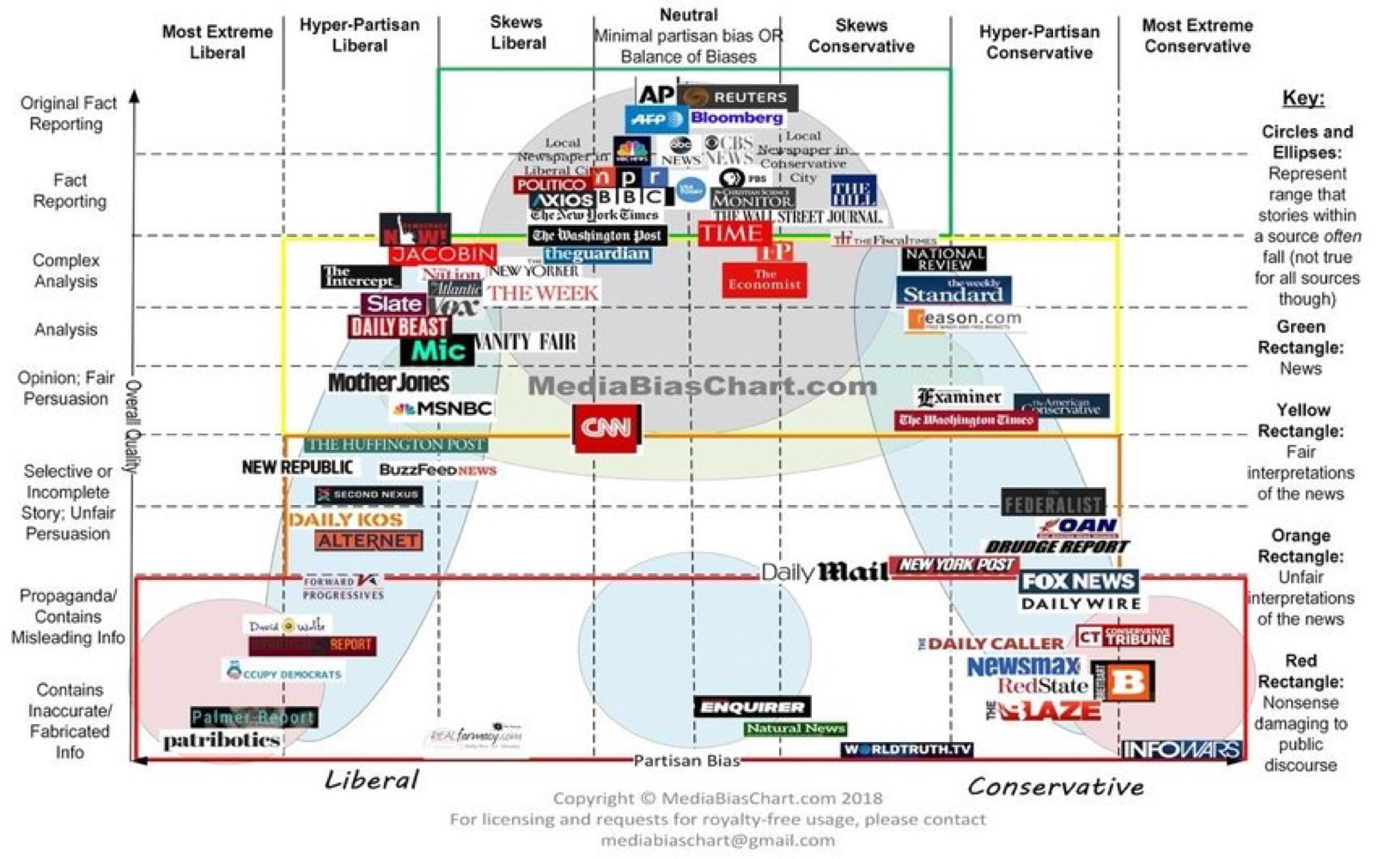
What’s in the news can depend on the source.
So reader beware.

Slide 3
Why everyone should be interested
in global ecology
The human influence on the global environment is changing our understanding of “nature”.
Our world is changing and is fundamentally different than the one we were born in to.
Our lives and livelihoods are threatened by actions that undermine the well being of our natural support systems.
Understanding global ecology is needed to assess & minimize our current and future impacts on natural support systems.
Ecological changes in the next 10 years will determine the type of world you and your children will live in.
Past ecological changes provide a context for current changes.
We won’t know what to do, if we don’t understand what’s going on

Slide 4
Notes:
Member of the Hudson River School.
Mid 19th century American art movement
Included Thomas Cole and Asher Durand.
The “…depicted a New World in which man, minuscule as he was beside the vastness of creation, nevertheless retained that divine spark that completed the circle of harmony.”
“Tiny as the human beings are in this composition, they are nevertheless elevated by the grandeur of the landscape in which they are in harmony.”
Nature was a manifestation of God.

Slide 5
Bill McKibben
The New Yorker
Sept. 11, 1989
The End of Nature
“… any clear dichotomy between pristine ecosystems and human-altered areas that may have existed in the past has vanished …”
Peter Vitousek 1994

Slide 6

Welcome to planet Eaarth!
Notes:
“Our old familiar globe is suddenly melting, drying, acidifying, flooding, and burning in ways that no human has ever seen. We've created, in very short order, a new planet, still recognizable but fundamentally different. We may as well call it Eaarth.”

Slide 7
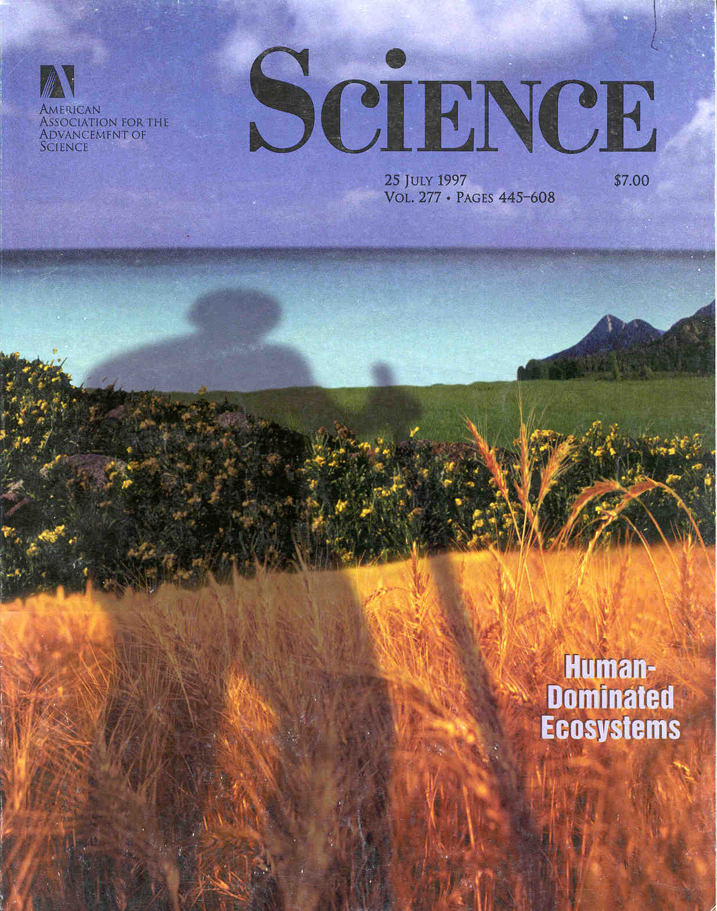
“The health of an economy cannot be
separated from that of its natural support systems.”
Lester R. Brown 2006 Plan B 2.0
Notes:
The livelihood of > 50% of the world’s people depends directly on forests, rangelands, croplands, and fisheries
Even more have jobs that depend on:
Forest products and the forest product industry
The leather goods industries
The cotton & woolen industries
Food processing

Slide 8
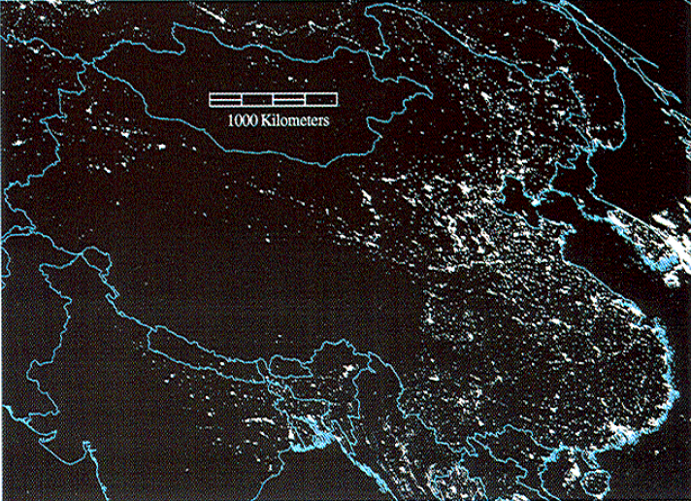
I = P*A*T
Elvidge et al. 1997

Slide 9
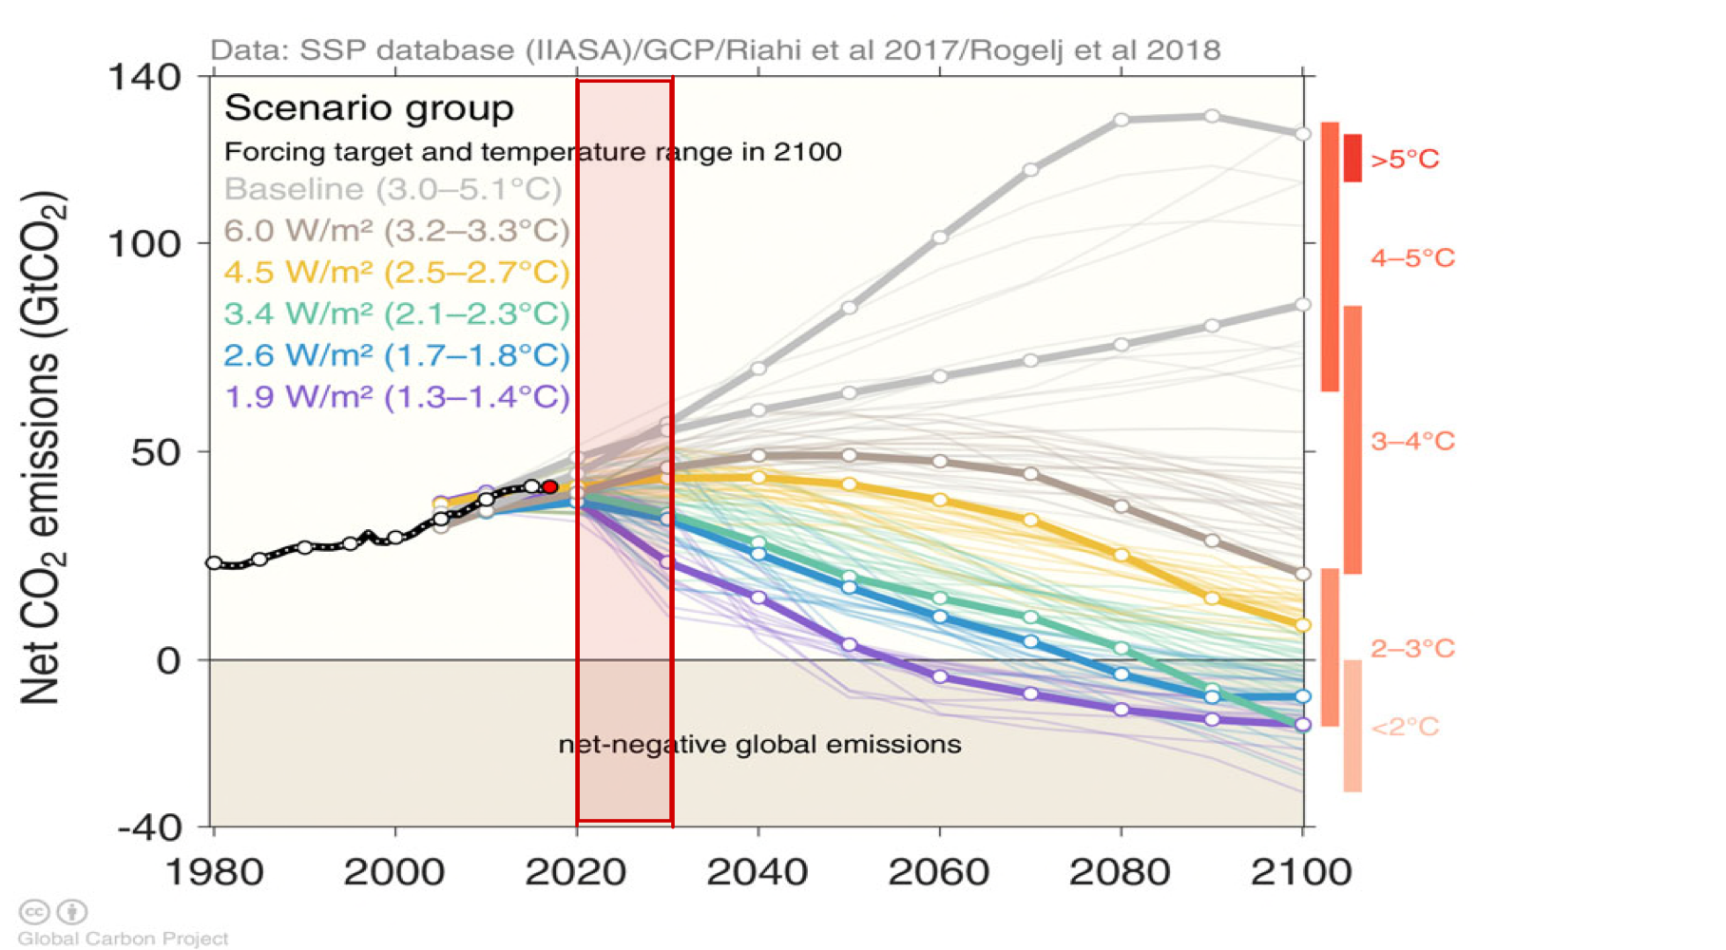
The next 10 years or so will determine the type of world you and your children will live in.

Slide 10
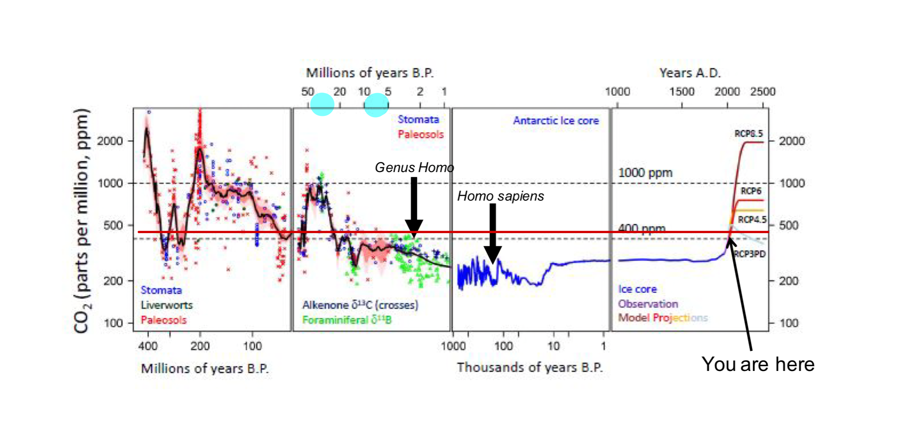

Slide 11
Our Capacity to Change the Earth Means We Must Manage it Wisely
Paraphrased from
Peter Vitousek
Time Magazine
August 20, 2001
We won’t know what to do, if we don’t understand what’s going on.
Two Main Themes of the Course
99.99% of Earth’s history
“The Anthropocene”
Notes:
Term anthropocene (a new epoch in geologic time) coined by Paul Crutzen to emphasize the effect of human activities on the global environment.

Slide 12
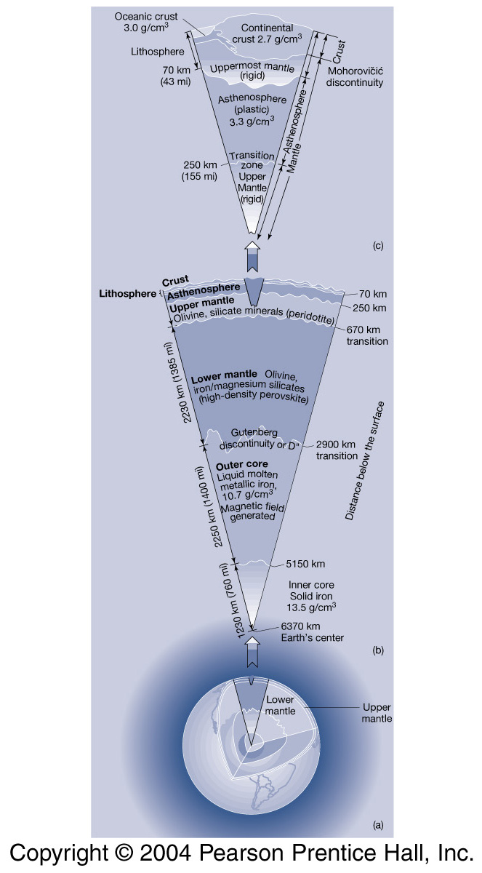
Mean density of Earth ~ 5.5 g/cm3
4.4 g/cm³
Kump et al. 2004

Slide 13
Standard Model of Planet Formation
Accretion
4.6-4.5 BYBP
Bombardment
4.5-3.8 BYBP
Protoplanetary
Disk
Planetary
Embryo
Protostar
Planetesimals
Planets
Dust -> Planetesimals
Planetesimals -> Planetary Embryos
(~ 1-10 % Mass of Earth)
Planetary Embryos -> Planets
Ahrens 1994

Slide 14
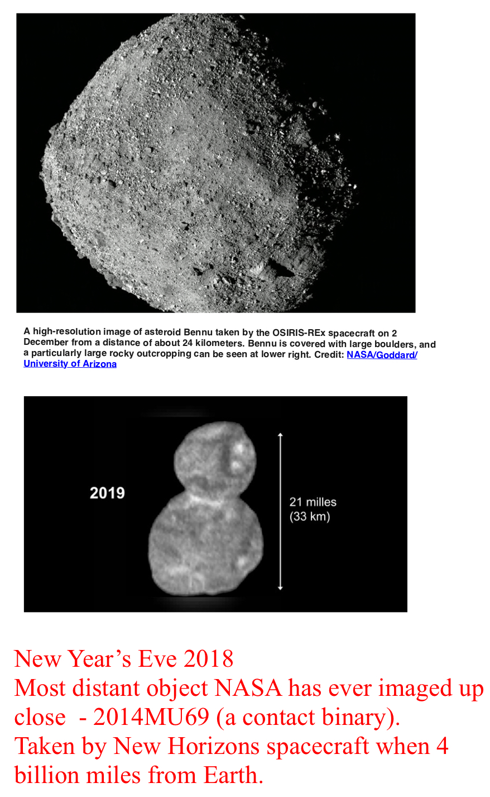
Brief History of our Solar System
Supernova – stellar explosion
Pre-solar Nebular – slowly spinning cloud of gas & micron-sized condensates
(i.e., star dust)
Encounter velocities ca. miles/hr to thousands of miles/hr
Dust => Particles => Gravels => Small Balls => Big Balls => Planetesimals
Non-gravitational cohesion (i.e., sticking) & gravitational instabilities form
planetesimals (rocky bodies 1-10 km in diameter)
If planetesimals had similar composition, then planets formed by
homogeneous accretion. If composition differed, then planet formed by
heterogeneous accretion.
In computer models, when diameter > ca. 1 km, then increased gravitational
attraction results in collisions of planetesimals.
With the largest planetesimals growing the fastest.
Planetesimals swept up within zones defining present-day orbits and
continues accretion leads to moon-sized bodies (radius ~ 1,700 km) called
planetary embryos.
Once lunar size, gravitational attractions result in inter-orbital collisions
(crossing orbits)
As Earth grew it probably experienced impacts from:
Hundreds of bodies with a radius of 10 km
Tens of bodies with a radius of 100 km
Several bodies with radius of 1,000 km
For perspective: The K-T (Cretaceous-Tertiary) impact had radius of ~ 5 km
(Earth’s radius is ~ 6,000 km) => extinction of ~75% of all species

Slide 15
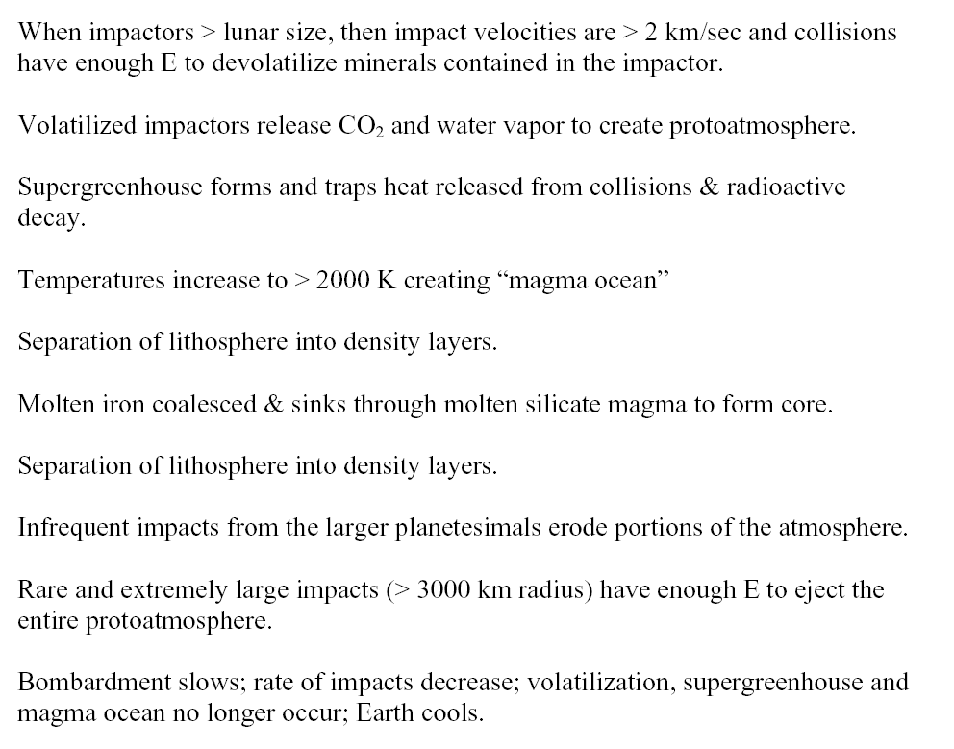

~4,474 mph

Slide 16
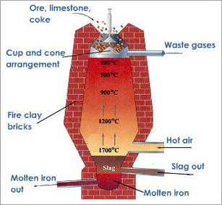
The Density Structure of the Lithosphere
Appears to be Due to
“Planetary Smelting”
Notes:
http://siddikabasemetalsmelting.weebly.com/lead-smelting.html
so even if earth formed by homogeneous accretion we would still get a structure based on density separation due to a planetary smelting event

Slide 17
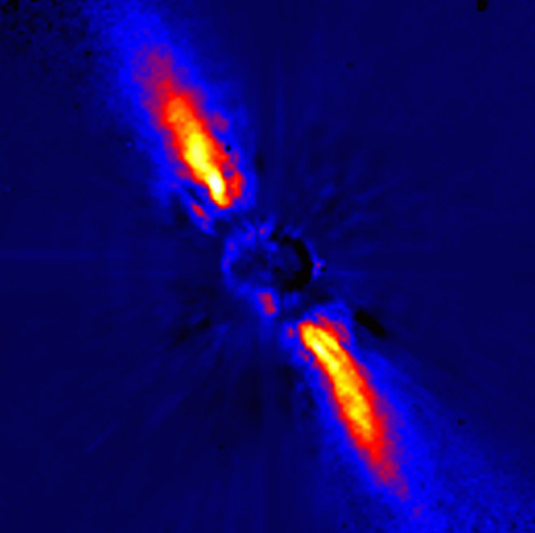
Beta Pictoris and its emerging solar system
The circumstellar disk shows (in false colors) the light reflected by dust around the young star
Notes:
http://imagine.gsfc.nasa.gov/docs/features/news/25jul06.html
This image of the circumstellar disk around Beta Pictoris shows (in false colors) the light reflected by dust around the young star at infrared wavelengths. (Credit: Jean-Luc Beuzit, et al. Grenoble Observatory, European Southern Observatory)
Scientists using NASA's Far Ultraviolet Spectroscopic Explorer, or FUSE, have discovered abundant amounts of carbon gas in a dusty disk surrounding a well-studied young star named Beta Pictoris.
The star and its emerging solar system are less than 20 million years old, and planets may have already formed. The abundance of carbon gas in the remaining debris disk indicates that the star's planets could be exotic, carbon-rich worlds of graphite and methane. Or conversely, the scientists say, Beta Pictoris and its environs might resemble our own solar system in its early days.
A team led by Dr. Aki Roberge of NASA Goddard Space Flight Center in Greenbelt, Md., presents the FUSE observation in the June 8 issue of Nature. The new measurements make Beta Pictoris the first disk of its kind whose gas has been comprehensively studied. The discovery settles a long-standing scientific mystery about how the gas has lingered in this debris disk yet raises new questions about the development of solar systems.
"There is much, much more carbon gas than anyone expected," said Roberge, a NASA Postdoctoral Fellow and lead author on the Nature report. "Could this be what our own solar system looked like when it was young? Are we seeing the making of exotic, new worlds? Either prospect is fascinating."
Beta Pictoris, about 60 light years away, is 1.8 times more massive than our sun. This young star's disk was discovered in 1984. Earlier observations have hinted that a Jupiter-like planet may have already formed in this disk and that rocky terrestrial planets may be forming. Such planets would be too small and faint to observe with current instruments.

Slide 18
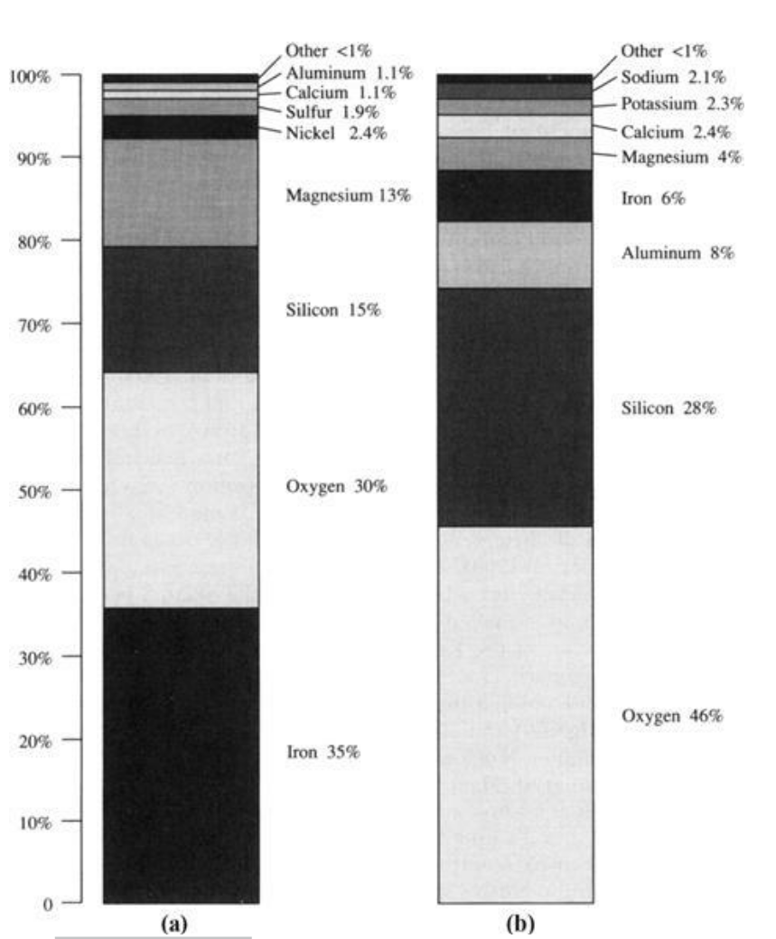
Mean density of Earth ~ 5.5 g/cm3
Whole Earth
Crust Only
4.4 g/cm³
Kump et al. 2004
Kump et al. 2004
Schlesinger 1997
Notes:
density of lower mantle about 4.4 g/cm3

Slide 19
Core
Composition
  Iron
  Nickel (~6 %)
Inner solid core
Outer liquid core
  Convective mixing
Convection in outer core creates the Earth’s magnetic field
Notes:
dynamo

Slide 20
Mantle
Mafic in composition
    Pyroxene (Mg, FeSiO₃)
    Olivine (Mg₂, Fe₂SiO₄)

Slide 21
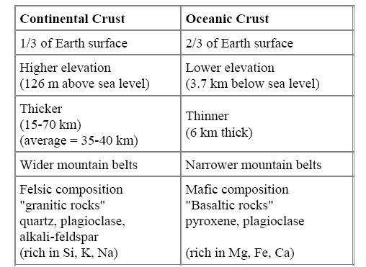
Two types of crust
(e.g. Ca Al₂ Si₂ O₈)
(e.g. Mg, Fe Si O₃)
Never subducted
Less dense
Older on average
< ~ 200 MYBP
Can be > 2 BYBP

Slide 22
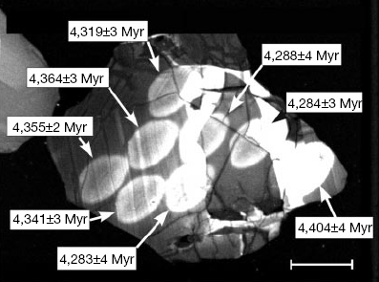
When the lithosphere form?
Cathodoluminescence and back-scattered electron images of zircon crystal W74/2-36.
With portions dated at 4.404 billion years.
Wilde S.A., Valley J.W., Peck W.H. and Graham C.M. (2001). "Evidence from detrital zircons for the existence of continental crust and oceans on the Earth 4.4 Gyr ago". Nature 409 (6817): 175–8. doi:10.1038/35051550. PMID 11196637.
Notes:
http://en.wikipedia.org/wiki/File:Zircon_crystal_NASA_Img.jpg
Contained in Jack Hills conglomerate – conglomerate is a coarse-grained sedimentary rock
Zircon is zirconium silicate
One of the highest-temperature and most stable minerals found in rocks (Langmuir & Broecker book)
Common but in low abundance.
Very stable and can survive weathering, transport, and often multiple melting events
Individual grains can be dated via U/Pb dating

Slide 23
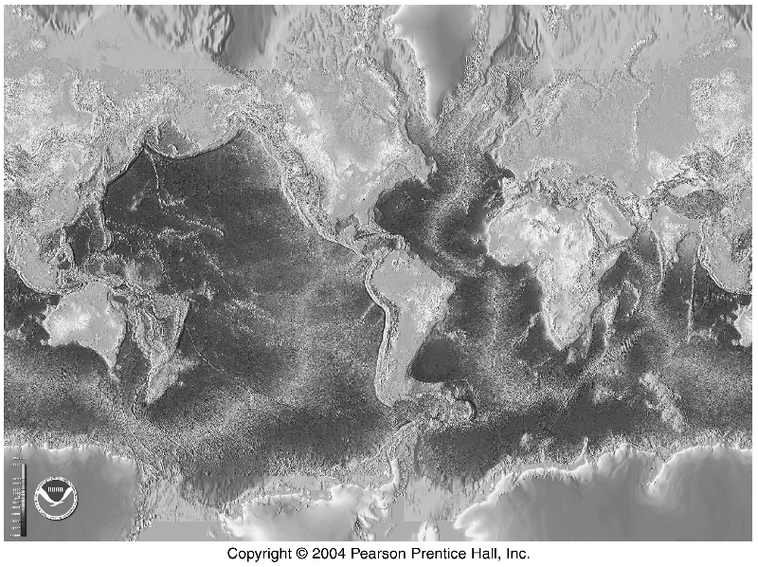
Ehrlich et al. 1977
Kump et al. 2004

Slide 24
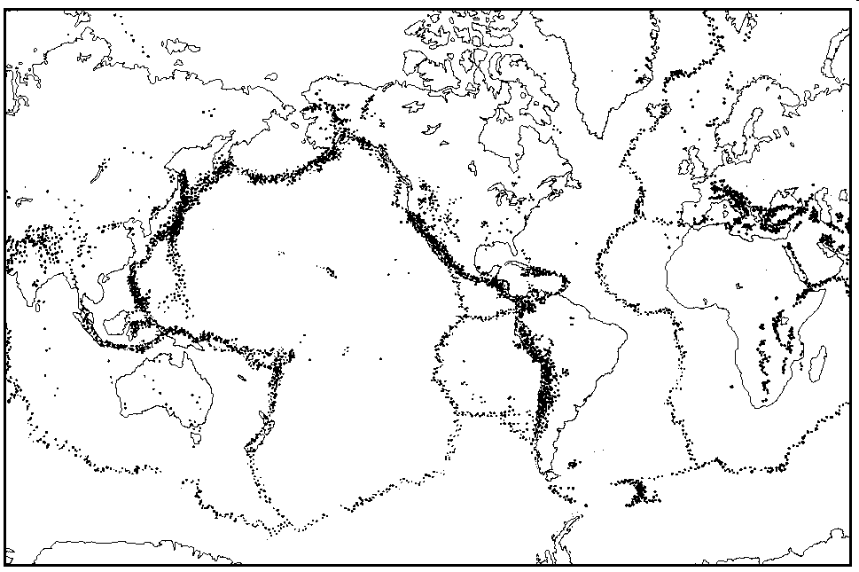
The world distribution of earthquakes. Earthquakes cluster along subduction and collision margins.
Notes:
http://geophysics.ou.edu/solid_earth/notes/seismicity/global/global_seismicity.html
Similar figure in Emiliani 1995

Slide 25
Push
~ 3.0 g/cm³
Dry
Mafic
~ 3.3 g/cm³
Change to eclogite with density up to 3.75 g/cm³
https://upload.wikimedia.org/wikipedia/commons/c/c0/Mid-ocean_ridge_topography.gif
Notes:
Eclogite is a metamorphic rock formed when mafic igneous rock is subjected to high pressure. Eclogite forms at pressures greater than those typical of the crust of the Earth. An unusually dense rock, eclogite can play an important role in driving convection within the solid Earth. Wikipedia

Slide 26
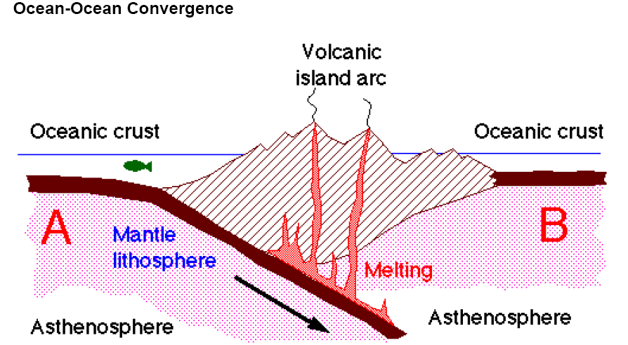
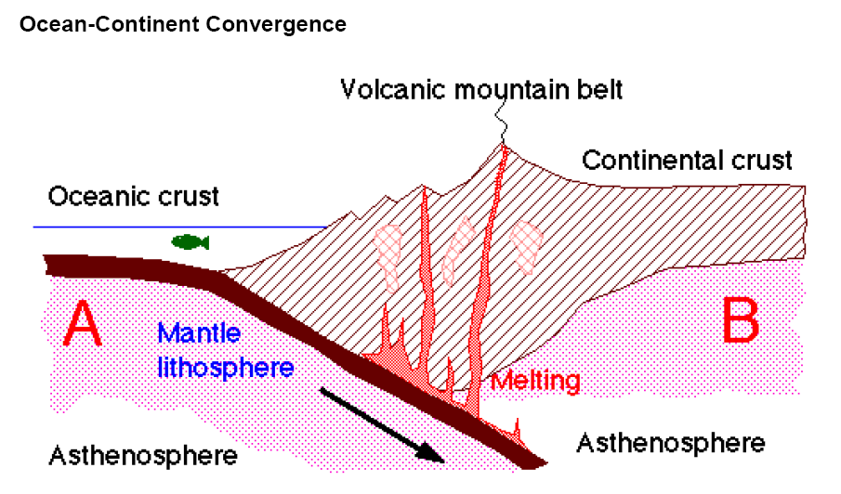
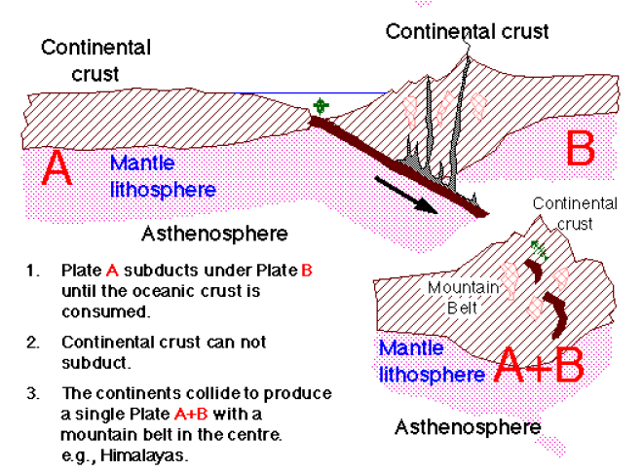

Slide 27
Press and Siever 1986
Notes:
Shows that nature has its own boundaries that don’t correspond to our own.

Slide 28
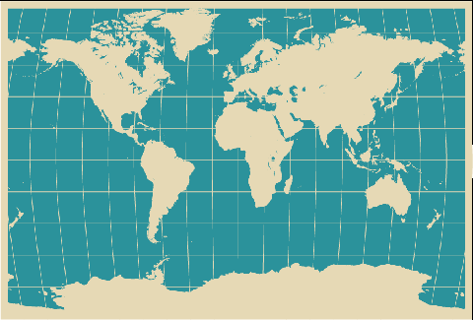
Have you ever noticed that the shape of eastern S. America could fit into the shape of western Africa?
Alfred Wegner did along with the correspondence of geological features, and fossils
Notes:
http://www.webresourcesdepot.com/free-vector-world-maps-collection/
The fact that tectonic plates move relative to one another raises some interesting questions and possibilities.

Slide 29
We now know that ~ 250 MYBP they did fit together to form Pangea
Solomon 1996
Notes:
Although, they did fit together, they aren’t together anymore.
Which means that the movement of tectonic plates tore Pangea apart and repositioned the pieces.

Slide 30
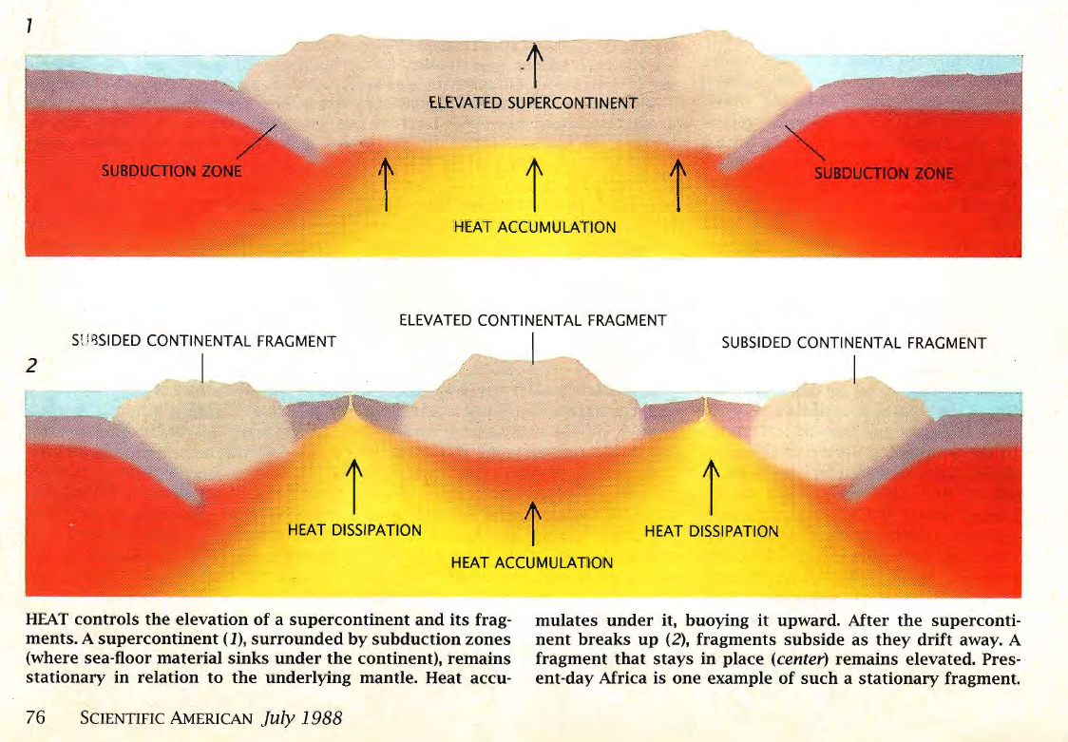
Oceanic Crust
Continental Crust
Oceanic Crust
Active
Margin
Passive
Margin
Nance et al 1988

Slide 31
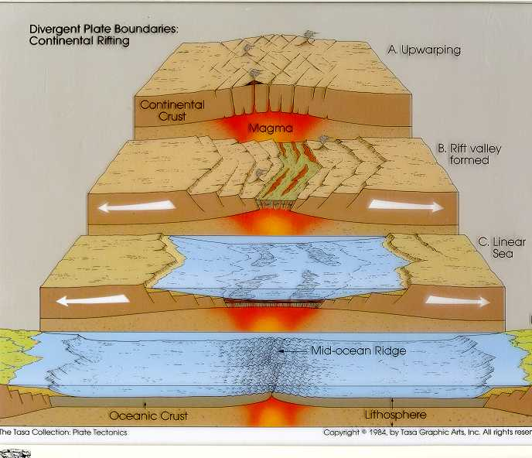
Rift Valley Formation

Slide 32
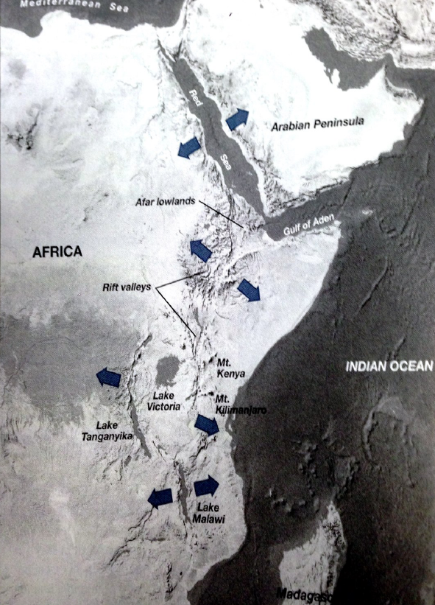
Rift Valleys of East Africa
Notes:
Fig. 7-17 Kump, Kasting, & Crane
Africa is being uparched and pulled apart. Continued spreading may result in the
Rift valley becoming an elongate sea like the Red Sea.

Slide 33
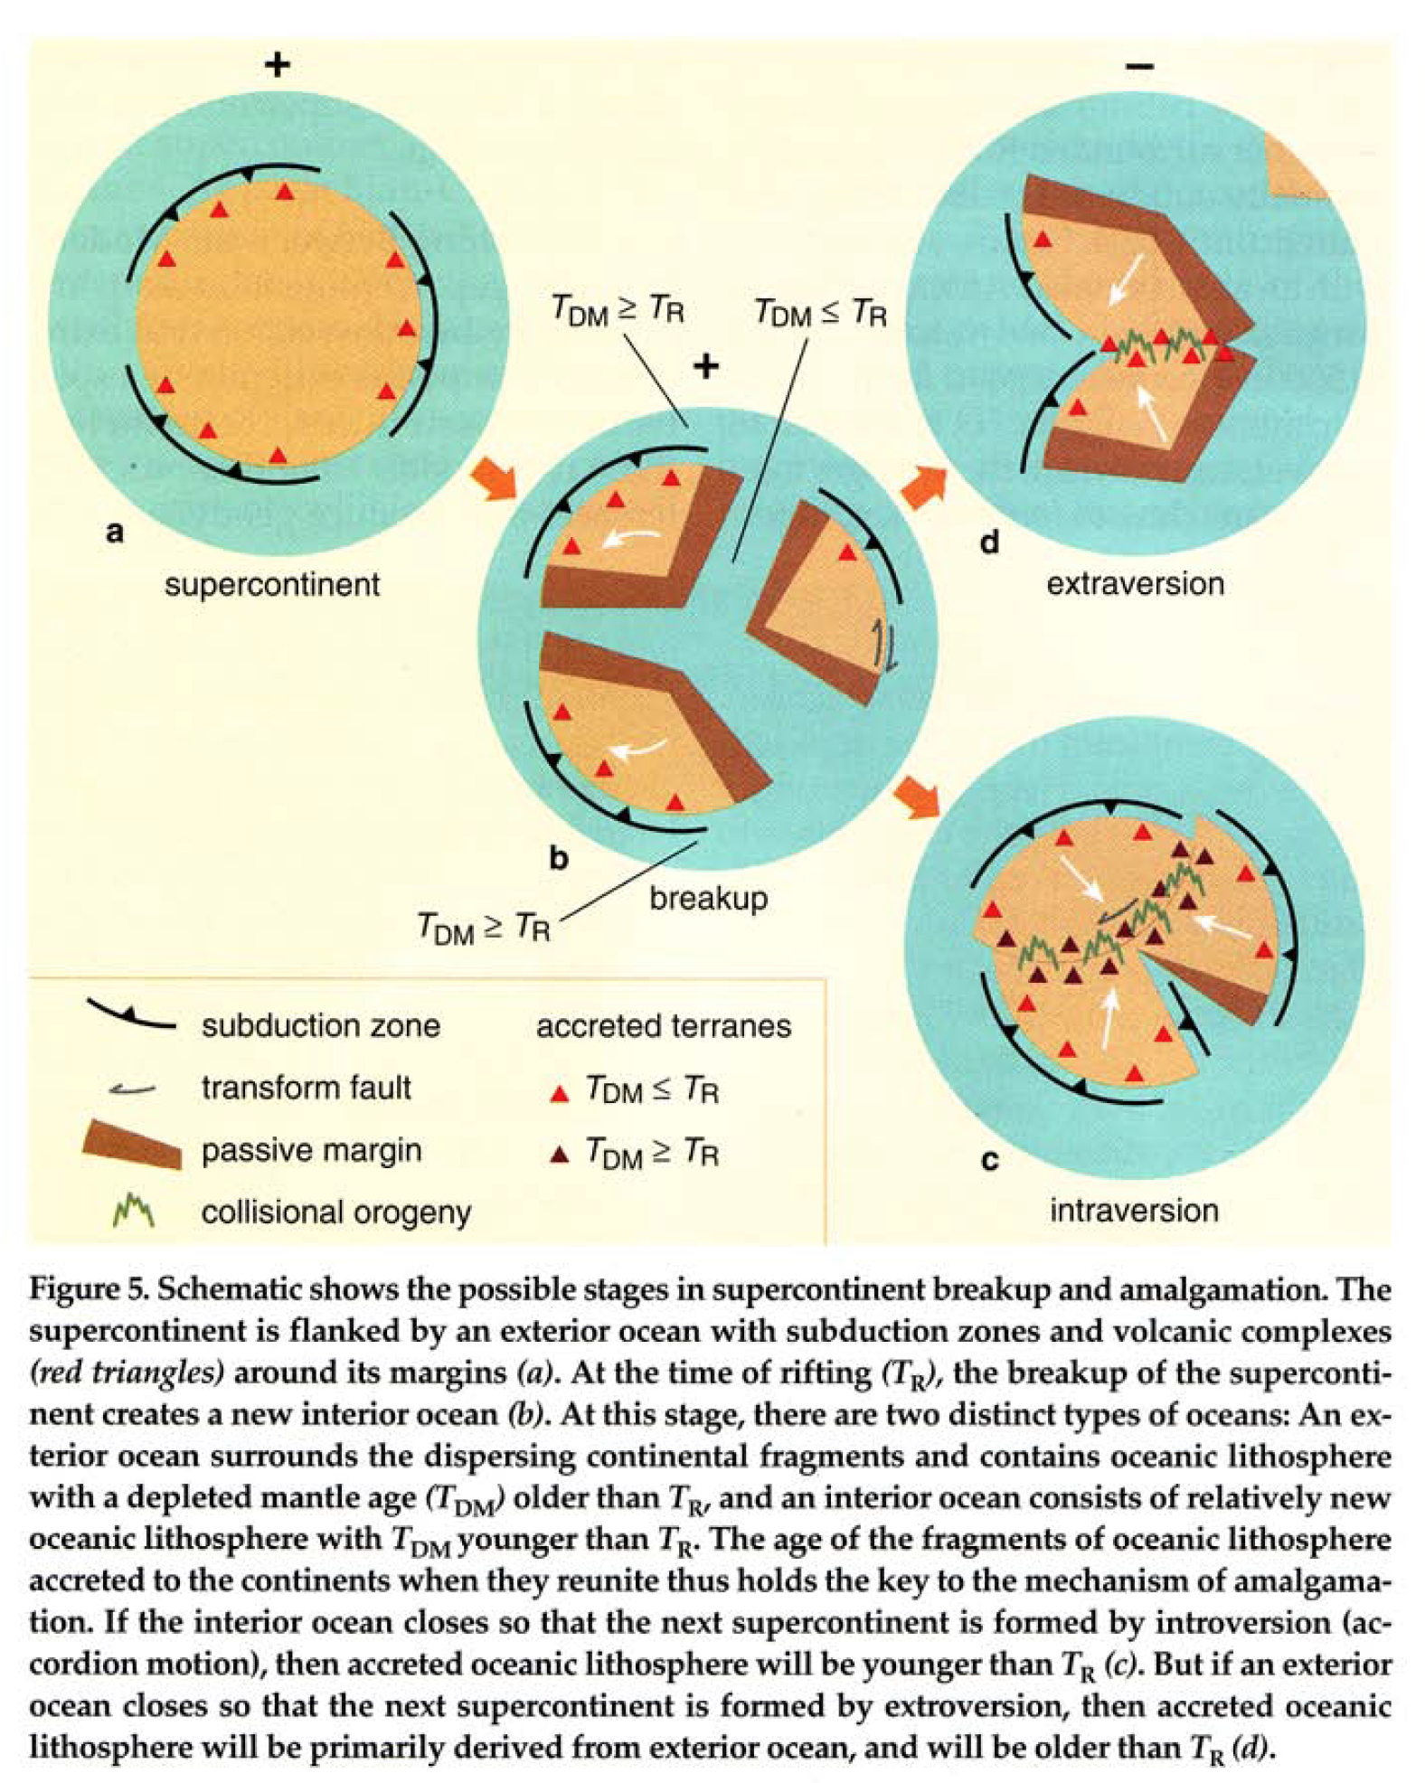
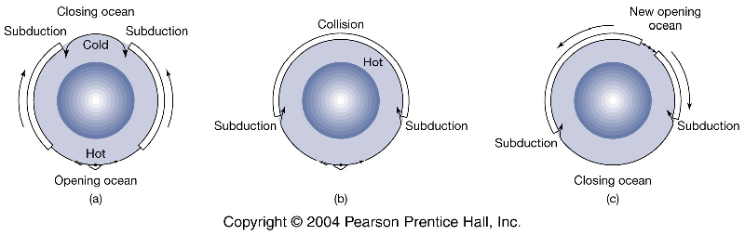
Extroversion
T_{DM} >= T_{R}
T_{DM} <= T_{R}
Introversion
“Accordian”
Murphy & Nance 2004
Extroversion
Kump et al. 2004

Slide 34
Notes:
http://www.ngdc.noaa.gov/mgg/image/crustalimages.html

Slide 35
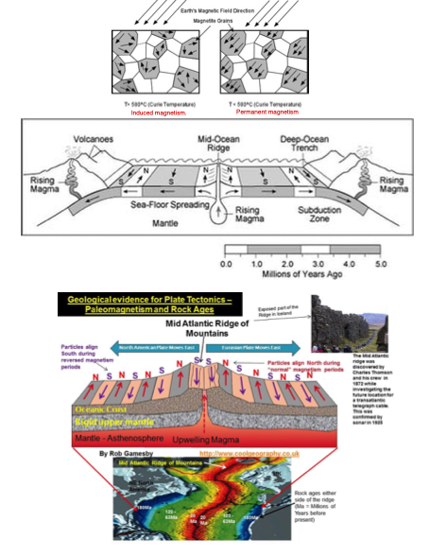
Notes:
https://youtu.be/JJEZ3Vizdww?t=60
There have been 183 reversals over the last 83 million years (on average once every ~450,000 years). The latest, the Brunhes–Matuyama reversal, occurred 780,000 years ago

Slide 36
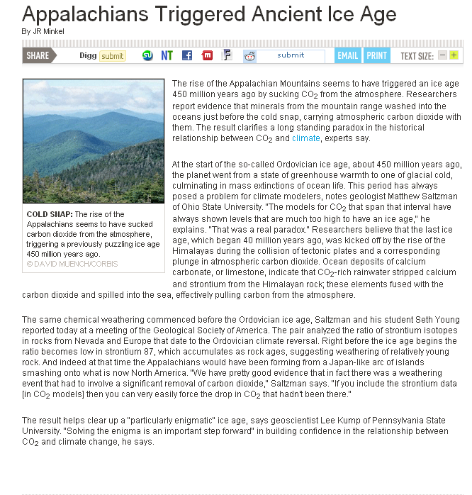
Notes:
http://www.sciam.com/article.cfm?id=appalachians-triggered-an

Slide 37
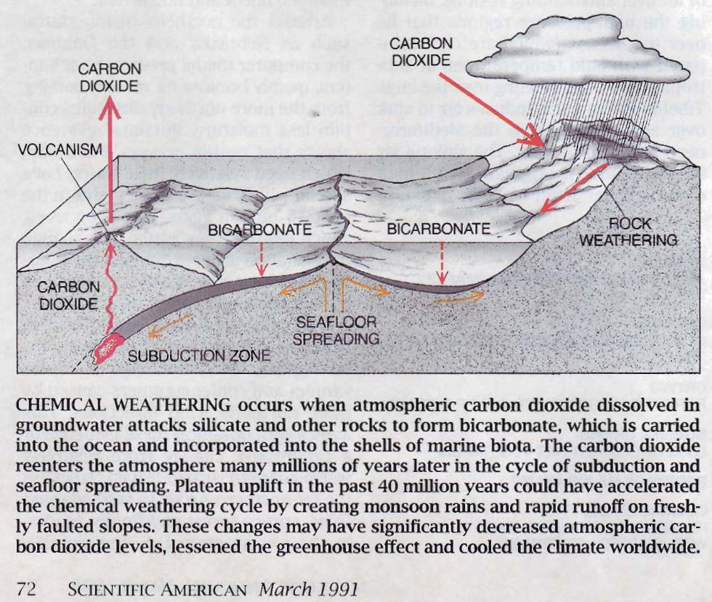
Ruddimann and Kutzbach 1991
Berner and Lasaga 1989

Slide 38
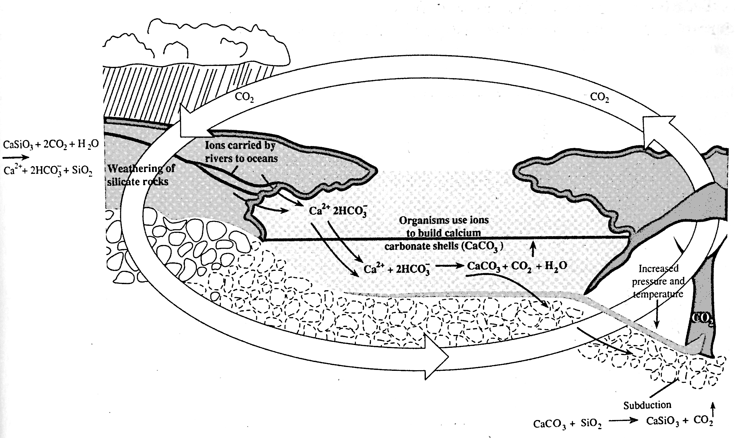
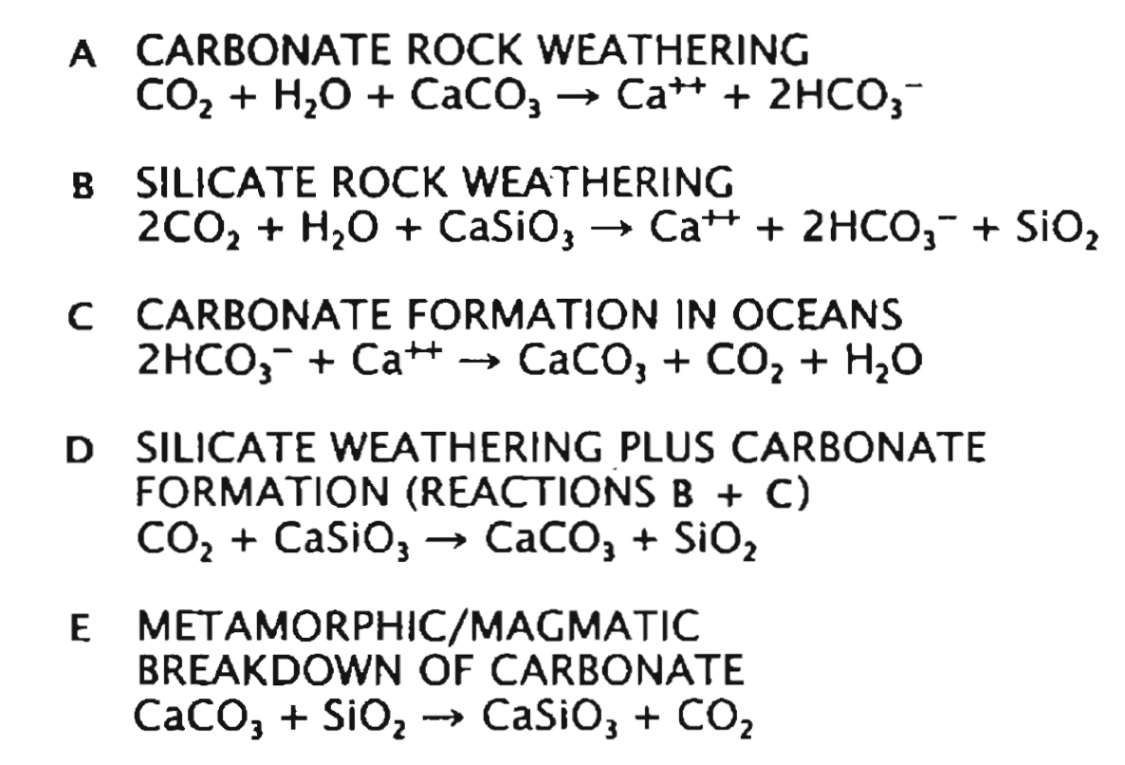
The silicate weathering CO₂ thermostat
Regulates atmospheric CO₂ and climate on geologic time scales.
B
Volcanic Emissions
C
Plate tectonics
E
Only works for silicate rocks!
Doesn’t work for limestone.
Temperature, moisture, & CO₂ sensitive
Igneous Rock
Sedimentary Rock
Urey Reaction
Rate of tectonic activity (mtn. uplift & volcanic degassing) controls the set-point of the
“thermostat” creating hot-house or ice age conditions

Slide 39
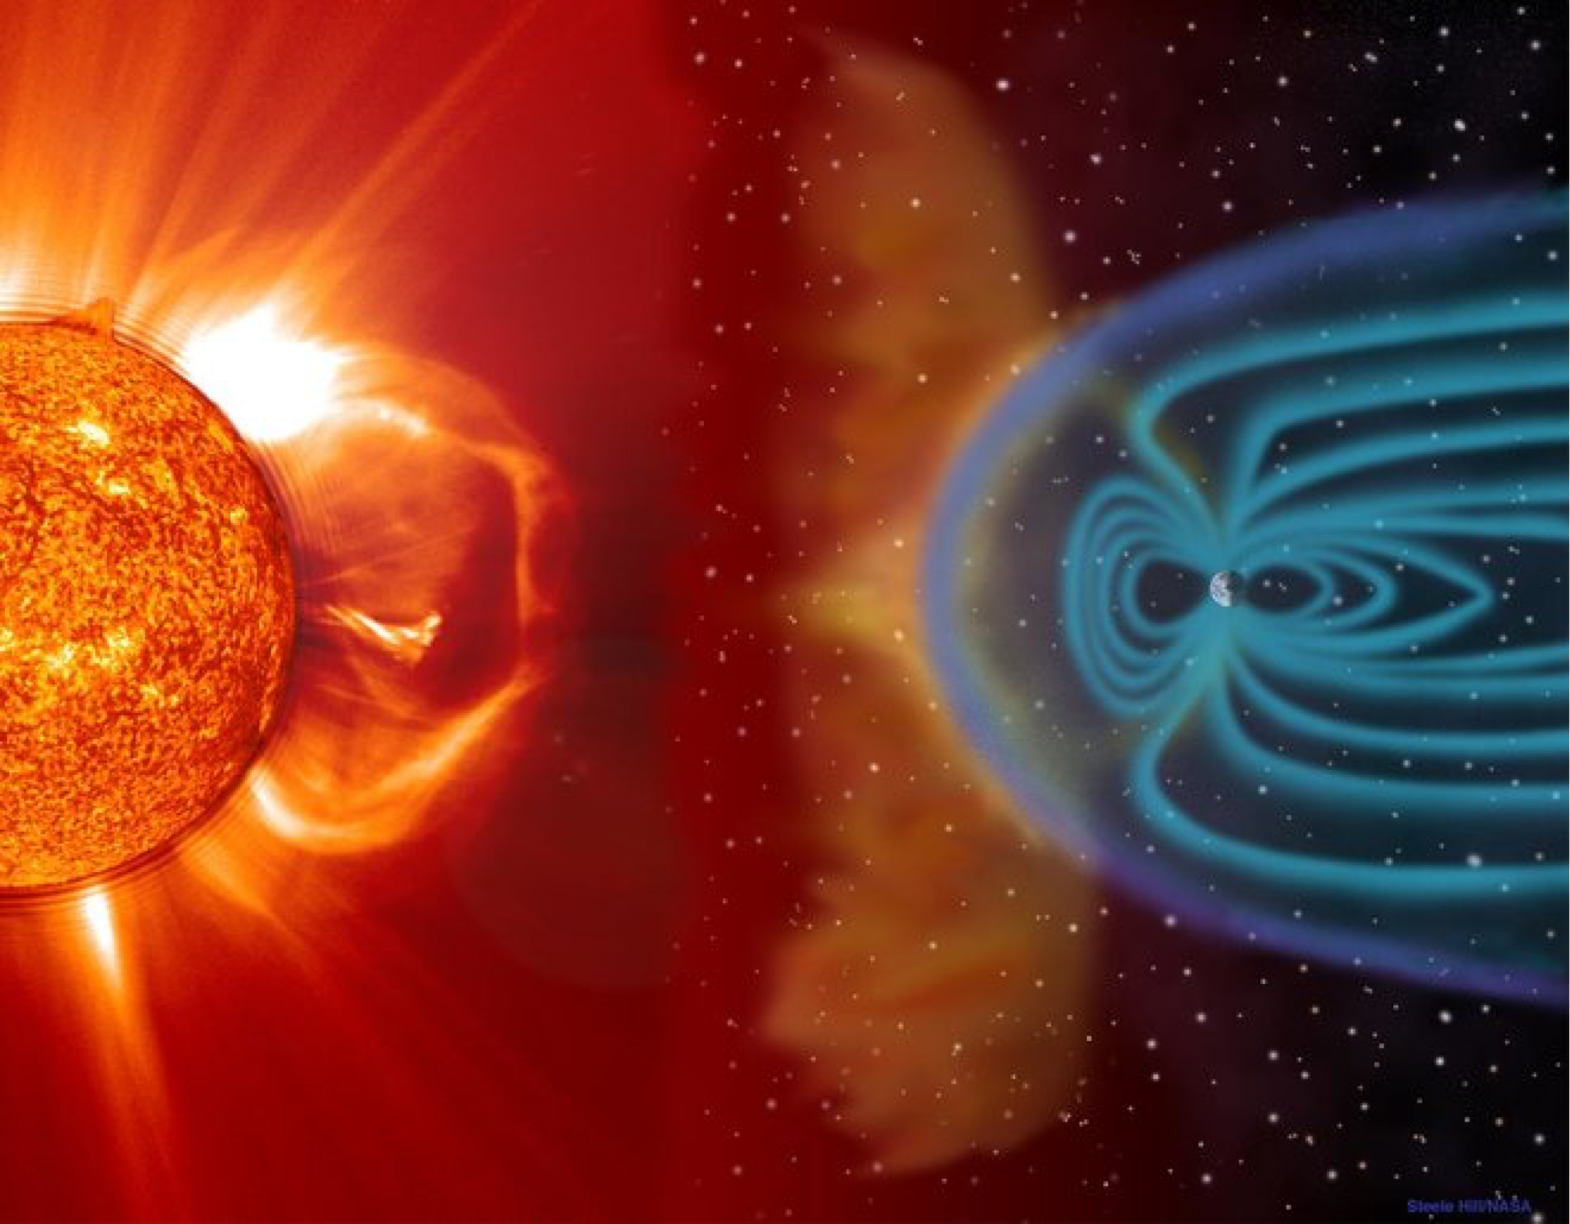
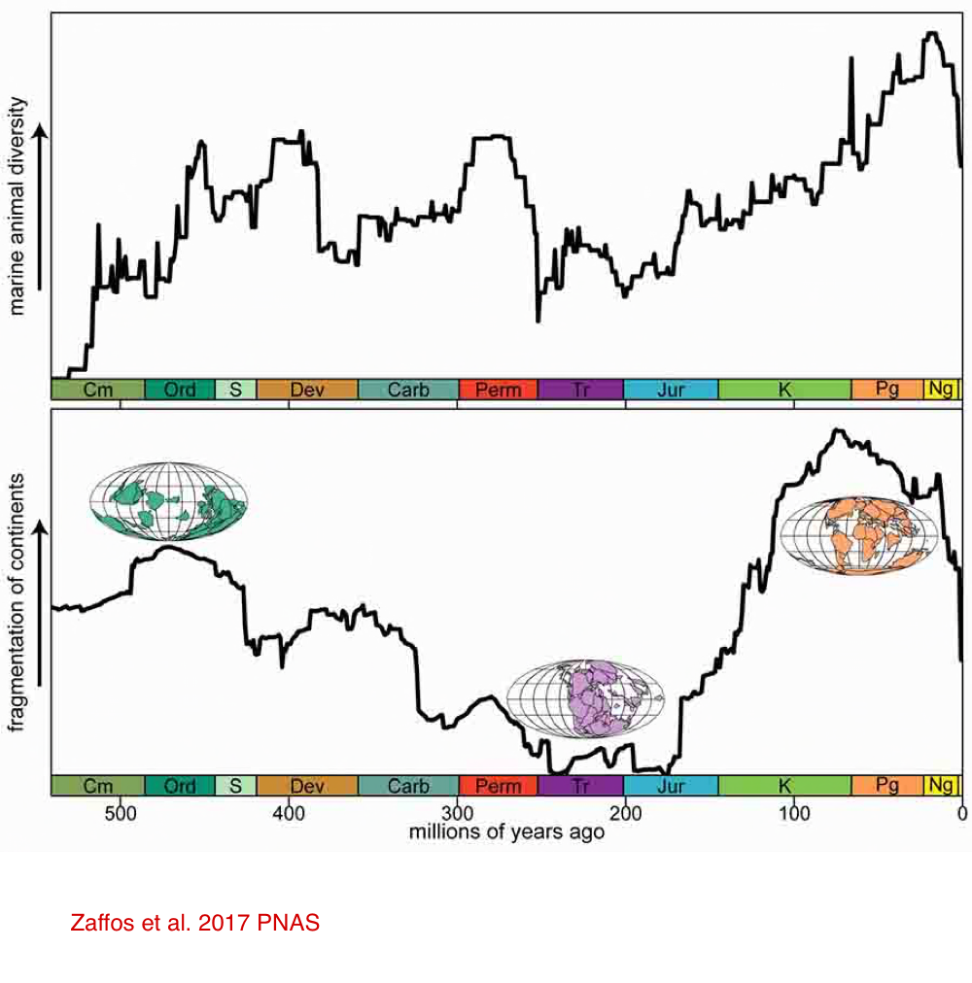
Protection from solar wind.
Emiliani 1995
Diversity of benthic shelf-dwelling invertebrates
Valentine and Moore 1970
Adapted by Cockell et al. 2007
Notes:
The solar wind is a stream of charged particles released from the upper atmosphere of the Sun, called the corona. This plasma mostly consists of electrons, protons and alpha particles with kinetic energy between 0.5 and 10 keV. Wikipedia
“Once the core formed a few tens of millions of years after accretion, Earth would have developed a magnetic field that deflected the solar wind, minimizing its effects on the atmosphere, preventing volatile loss, and protecting the surface from ionizing radiation harmful to life”
Excerpt From
How to Build a Habitable Planet
Charles H. Langmuir & Wally Broecker
It’s been hypothesized that times of increased diversity result from an increase in the number of biological provinces and climatic zonation caused by fragmentation and separation of continents (Cowen 1995 pgs. 98-100).
The contribution bringing continents together makes to loss of species is uncertain and may be modest (Rosenzweig 1996 pgs.279-284)
See also Wilson 1992 (The Diversity of Life) pgs. 194-195

